Slide 1
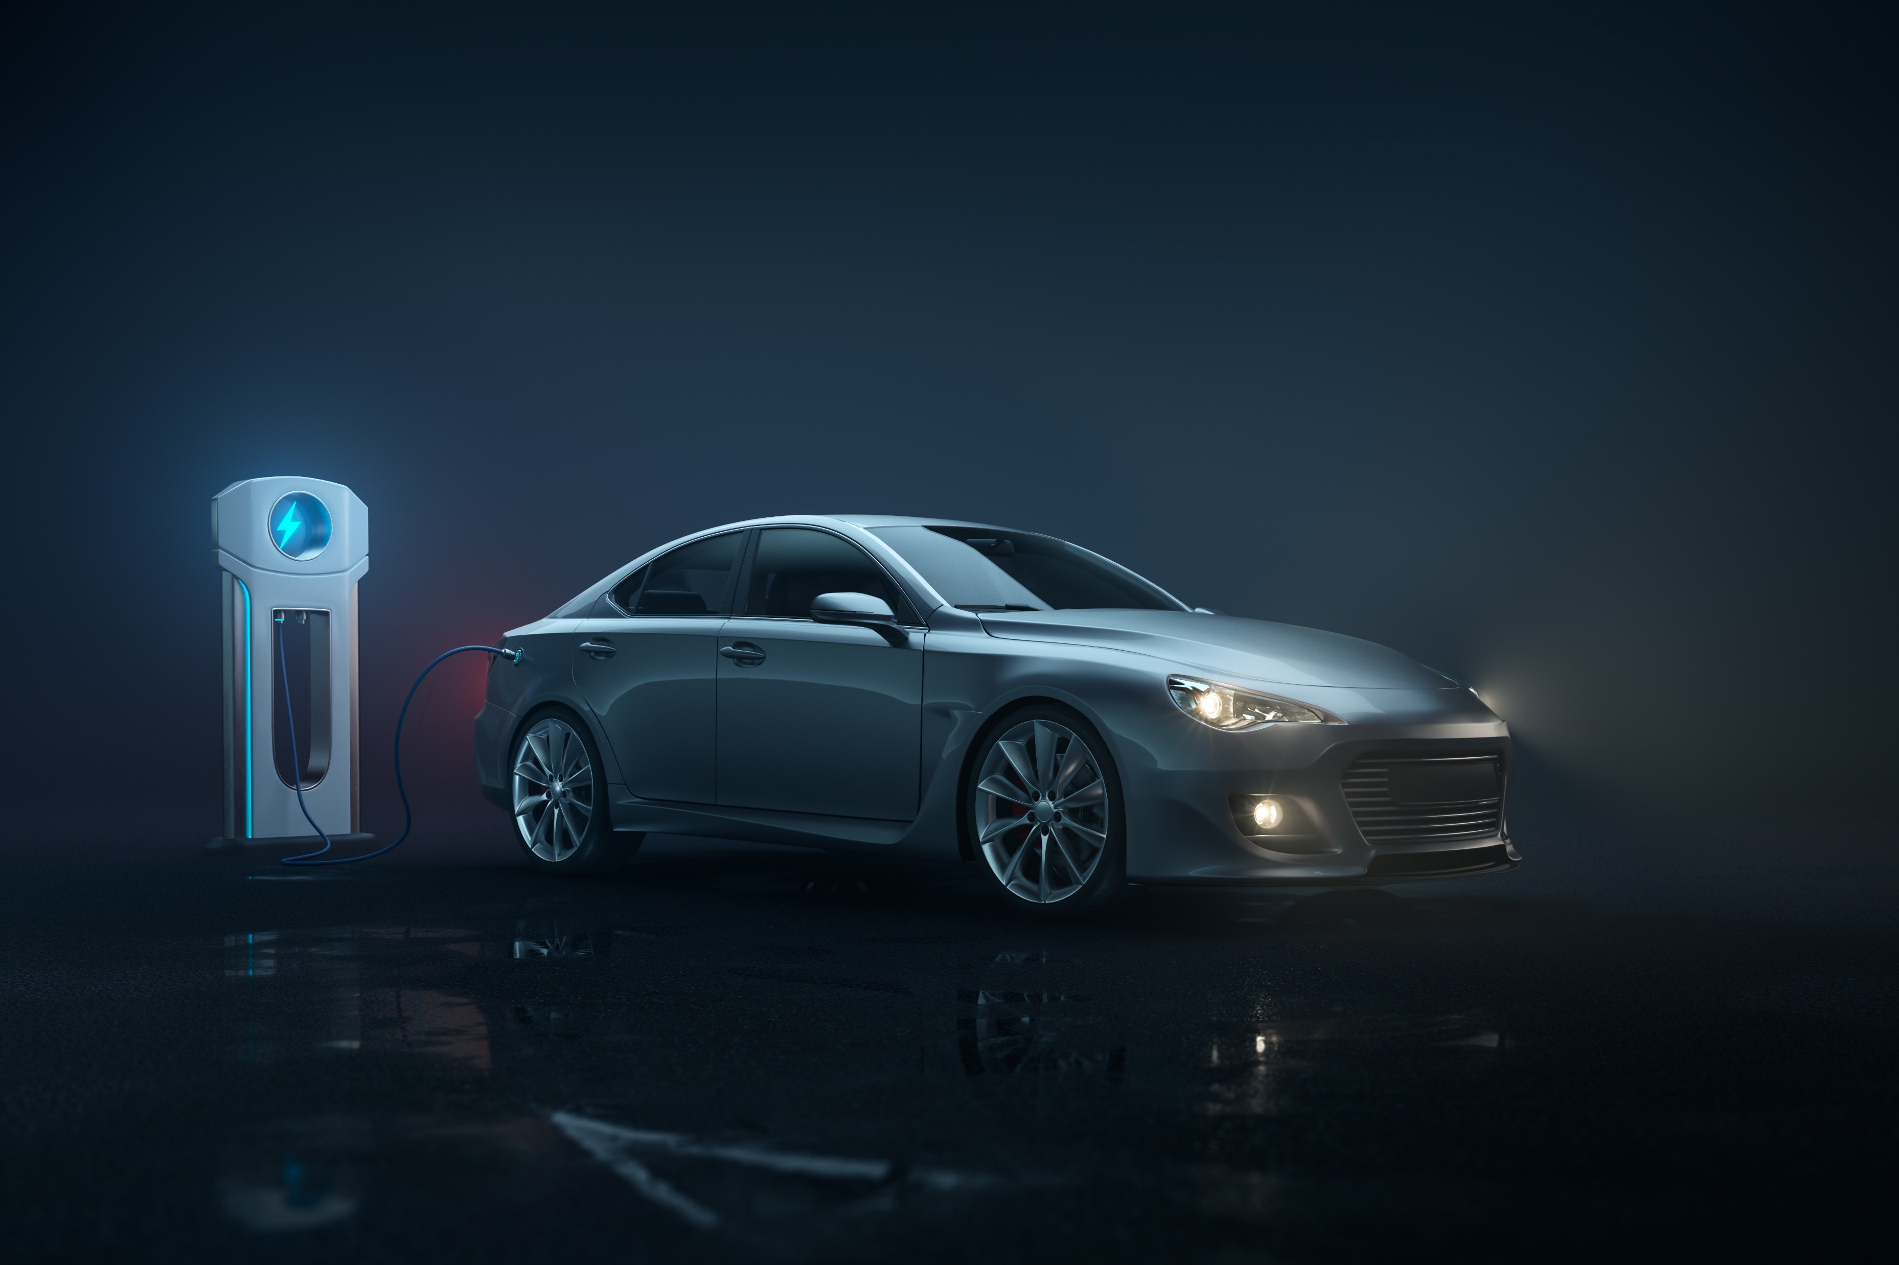
AtliQ Motors EV/Hybrid Market Study
Executive Data Reporting

Slide 2
Problem Statement and purpose
AtliQ Motors is an automotive giant from the USA specializing in electric vehicles (EV). In the last 5 years, their market share rose to 25% in electric and hybrid vehicles segment in North America. As a part of their expansion plans, they wanted to launch their bestselling models in India where their market share is less than 2%.
It is necessary to do a detailed market study of existing EV/Hybrid market in India before proceeding further, so we have 10 request to resolve

Slide 3
Requests
Who were the top three and bottom three manufacturers in terms of 2-wheeler sales for the fiscal years 2023 and 2024?
Which five states had the highest EV penetration rates for 2-wheelers and 4-wheelers in FY 2024?
Which states saw a decline in EV sales from 2022 to 2024?
What were the quarterly sales trends for the top five 4-wheeler EV manufacturers from 2022 to 2024?
How did EV sales and penetration rates in Delhi compare to Karnataka in 2024?
What was the compounded annual growth rate (CAGR) for 4-wheeler units among the top five manufacturers from 2022 to 2024?
Which ten states had the highest CAGR in total vehicle sales from 2022 to 2024?
What are the peak and low months for EV sales based on data from 2022 to 2024?
Based on past CAGR, what is the projected number of EV sales (including 2-wheelers and 4-wheelers) for the top ten states by penetration rate in 2030?
What is the estimated revenue growth rate for 4-wheelers and 2-wheelers EVs in India from 2022 to 2024 and 2023 to 2024, assuming an average unit price?

Slide 4
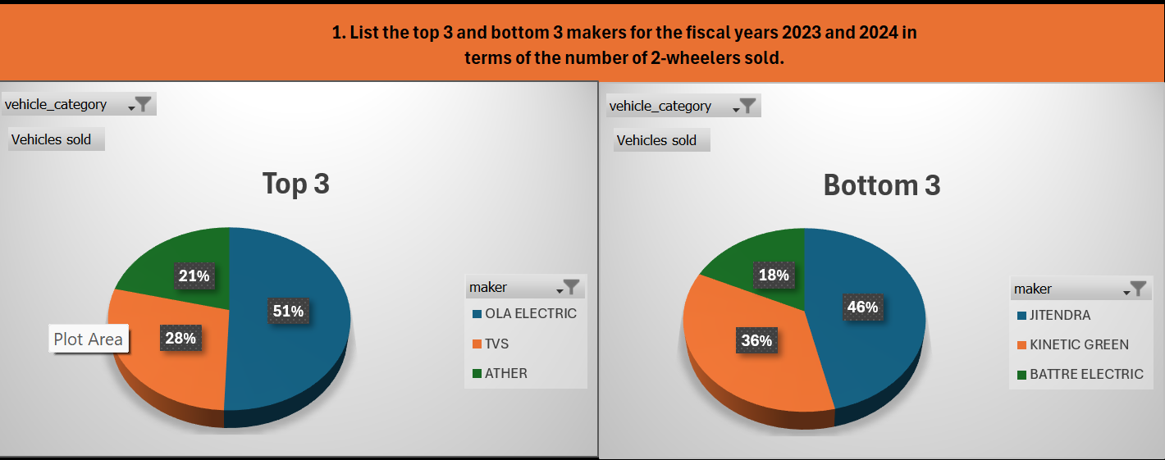
Request 1

Slide 5
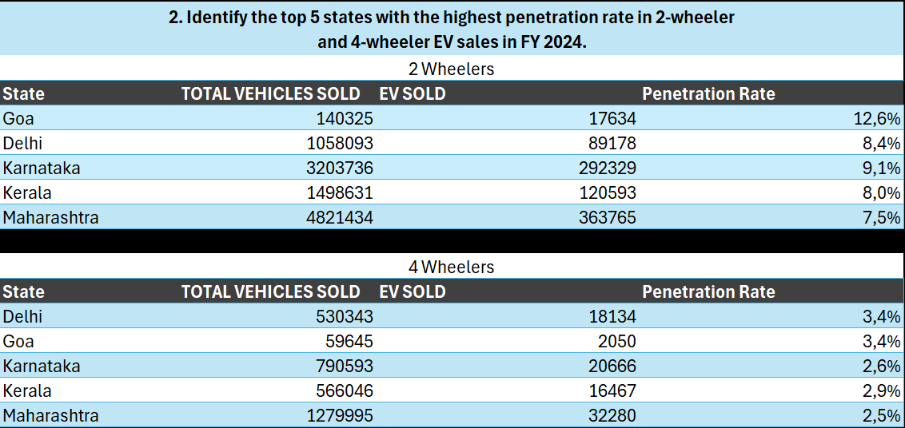
Request 2 arreglar

Slide 6

Request 3 Arreglar

Slide 7
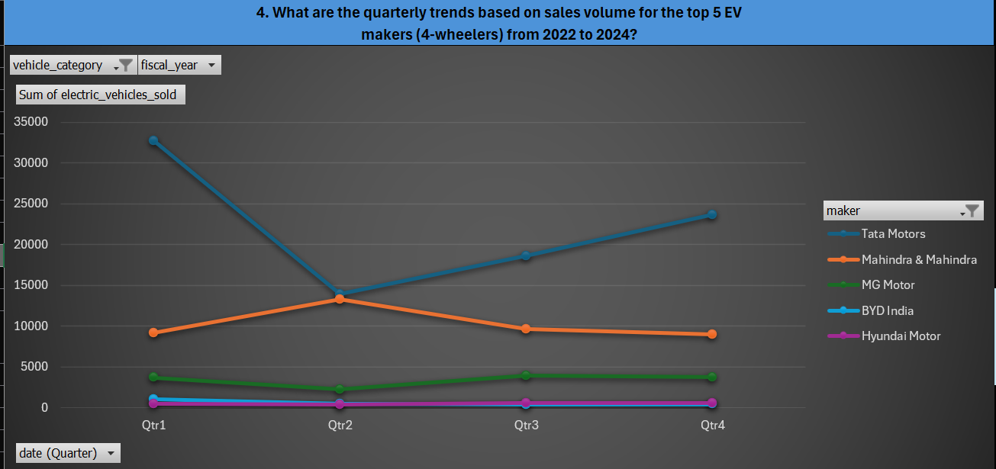
Request 4

Slide 8
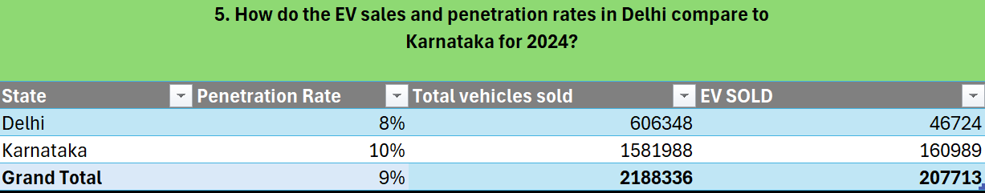
Request 5

Slide 9
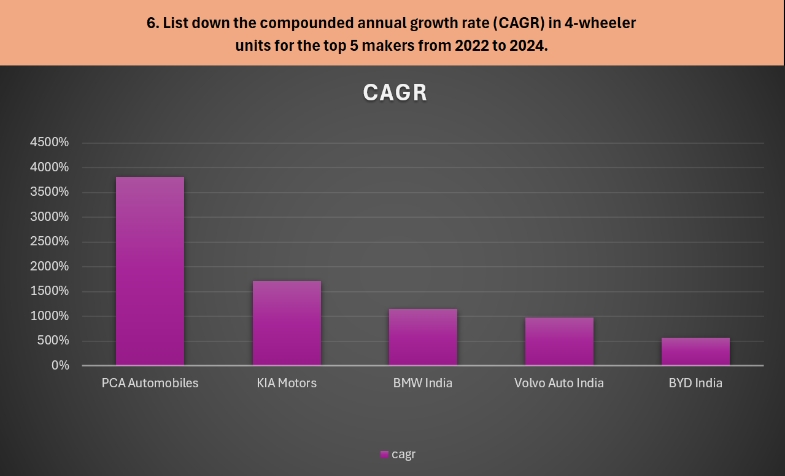
Request 6

Slide 10
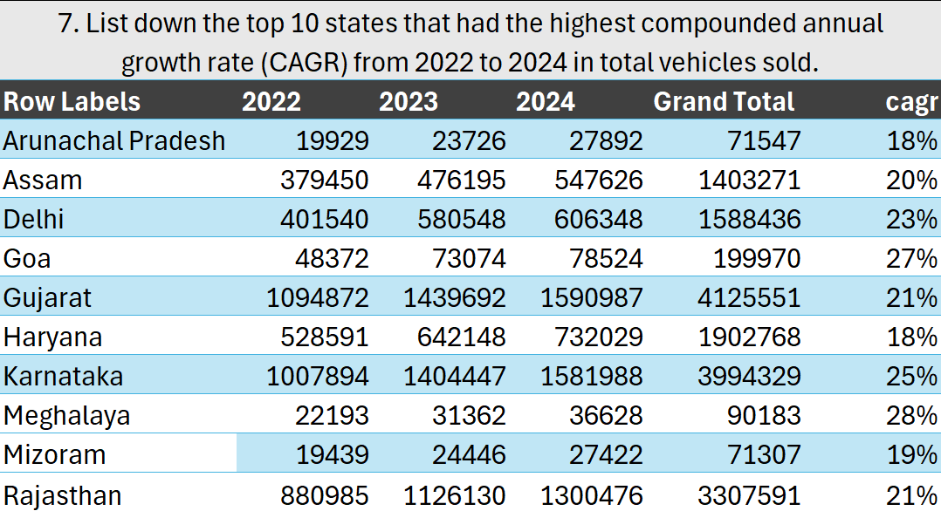
Request 7

Slide 11
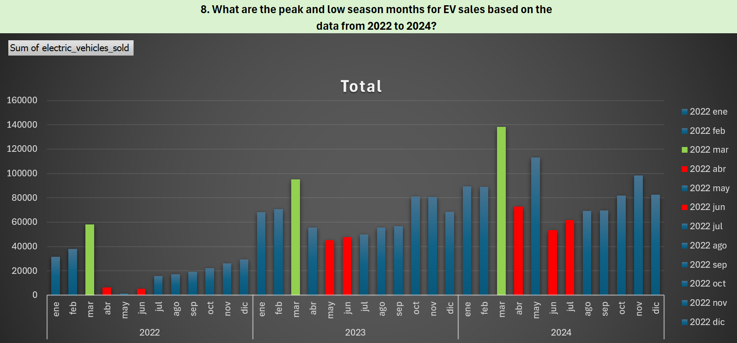
Request 8

Slide 12
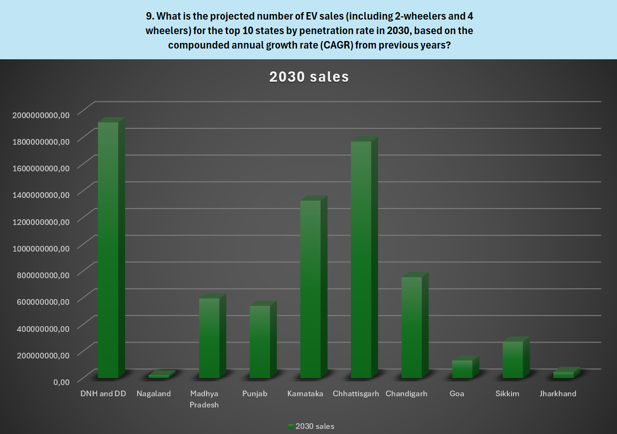
Request 9 Arreglar

Slide 13
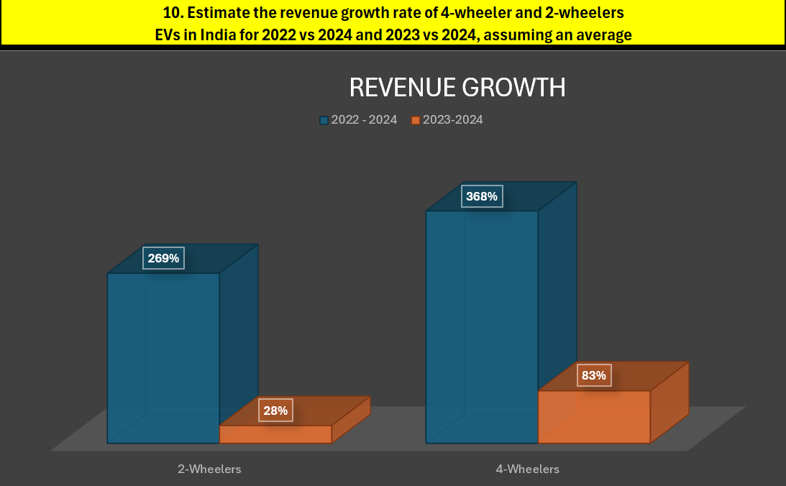
Request 10

Slide 14
Secondary Research Questions:
1. What are the primary reasons for customers choosing 4-wheeler EVs in 2023 and 2024 (cost savings, environmental concerns, government incentives)?
2. How do government incentives and subsidies impact the adoption rates of 2-wheelers and 4-wheelers? Which states in India provided most subsidies?
3. How does the availability of charging stations infrastructure correlate with the EV sales and penetration rates in the top 5 states?
4. Who should be the brand ambassador if AtliQ Motors launches their EV/Hybrid vehicles in India and why?
5. Which state of India is ideal to start the manufacturing unit? (Based on subsidies provided, ease of doing business, stability in governance etc.
6. Top 3 recommendations for AtliQ Motors.

Slide 15
Question 1
What are the primary reasons for customers choosing 4-wheeler EVs in 2023 and 2024 (cost savings, environmental concerns, government incentives)?
In 2023 and 2024, key factors driving 4-wheeler EV adoption in India include:
Cost Savings: Lower running and maintenance costs, alongside favorable total cost of ownership despite high initial prices.
Environmental Concerns: EVs reduce emissions, appealing to consumers mindful of air quality and sustainability.
Government Incentives: Subsidies, tax benefits, and incentives under FAME, along with state-level perks, reduce EV costs and expand charging infrastructure.
Technological Advancements: Enhanced battery tech extends range and improves performance, with more model options available.
Brand Image and Status: EVs represent innovation and environmental awareness, with automakers offering luxury features for status-driven buyers.
These factors are fueling EV popularity across India.

Slide 16
Question 2
How do government incentives and subsidies impact the adoption rates of 2-wheelers and 4-wheelers? Which states in India provided most subsidies?
Impact of Government Incentives and Subsidies
Reduced Upfront Costs:
2-Wheelers: Subsidies lower the purchase price, making EVs affordable for lower and middle-income buyers, a key factor when switching from traditional vehicles.
4-Wheelers: Government incentives help reduce the high upfront costs of electric cars, making them financially competitive with ICE vehicles and more appealing to cost-sensitive buyers.
Enhanced Total Cost of Ownership (TCO) Benefits:
Long-Term Savings: Subsidies, tax benefits, and reduced fees contribute to a lower TCO, making EVs attractive to consumers focused on long-term savings.
Boosted Market Demand:
Sales Increase: Higher subsidies correlate with a rise in sales as reduced price barriers make EVs more accessible.
Regional Market Penetration: EV adoption is higher in regions with greater incentives, indicating financial incentives' role in market penetration.
Manufacturer Encouragement:
Increased Production and R&D: Incentives encourage manufacturers to boost production and invest in new models, supporting further adoption.
Localization of Manufacturing: Government support for local production helps lower costs, making EVs more affordable.
States Offering the Most EV Subsidies
Delhi:
Subsidies: Significant subsidies for both 2-wheelers and 4-wheelers, with road tax and registration fee waivers.
Infrastructure: Extensive charging infrastructure supports adoption.
Maharashtra:
Subsidies: Among the highest subsidies, with incentives per kWh of battery capacity and tax waivers.
Tax Benefits: Waivers on road tax and registration fees further reduce TCO.
Gujarat:
Subsidies: Attractive subsidies aim to make EVs accessible to a wider demographic.
Charging Infrastructure: Investment in charging networks supports widespread adoption.
Tamil Nadu:
Subsidies: Focused on supporting EV manufacturing and consumer adoption.
Industry Support: Incentives for manufacturers encourage local production, lowering consumer costs.
Karnataka:
Subsidies: Focused on boosting both EV adoption and industrial development in the sector.
Policy Support: The state aims to become a hub for EV manufacturing, driving down costs and encouraging adoption.
National and state-level incentives together create a favorable environment for the growth of India's EV market by reducing costs and supporting infrastructure, production, and demand.

Slide 17
Question 3
3. How does the availability of charging stations infrastructure correlate with the EV sales and penetration rates in the top 5 states?
The availability of charging infrastructure is a key driver of EV sales and market penetration in India’s top states. Here’s how this relationship unfolds:
Consumer Confidence:
Charging infrastructure reduces range anxiety, making buyers more confident in choosing EVs, directly impacting sales in states with robust networks.
Convenience and Accessibility:
States with wide coverage across urban and rural areas see higher adoption, as the convenience of nearby charging stations encourages practical, daily EV use.
Government and Private Sector Initiatives:
Policies promoting charging stations, supported by public-private partnerships, boost infrastructure, making EVs more viable.
Integrated Development with Urban Planning:
Charging stations strategically located in new developments and integrated with city planning increase EV appeal and sales.
Top 5 States with Strong Charging Networks
Delhi: Extensive network with incentives for private charging points drives high EV adoption.
Maharashtra: Rapid expansion in cities like Mumbai and Pune supports growing EV sales.
Gujarat: Statewide coverage, including highways and small towns, has driven notable adoption.
Tamil Nadu: Growing infrastructure in cities like Chennai fuels EV market growth.
Karnataka: Focus on fast-charging, especially in Bangalore, supports high 4-wheeler sales.
In summary, well-developed charging networks reduce range anxiety, increase accessibility, and make EVs an attractive, practical option, accelerating EV adoption in India

Slide 18
Question 4
4. Who should be the brand ambassador if AtliQ Motors launches their EV/Hybrid vehicles in India and why?
Selecting the right brand ambassador is key for AtliQ Motors’ EV/Hybrid vehicles to resonate with the Indian market. Here are top candidates and their potential impact:
Virat Kohli:
Why: A highly respected sports figure embodying discipline, innovation, and excellence, values that align well with AtliQ Motors' vision.
Appeal: Virat’s wide demographic reach—young professionals and sports fans—makes him versatile for promoting modern, sustainable vehicles.
Deepika Padukone:
Why: Known for her advocacy for mental health and sustainability, she appeals to eco-conscious and style-driven consumers.
Appeal: Deepika resonates with young women and urban audiences, enhancing the brand’s stylish, eco-friendly image.
Akshay Kumar:
Why: His association with fitness, discipline, and social causes aligns with EVs as a responsible, sustainable choice.
Appeal: Broad appeal across regions and age groups, especially among middle-class families.
Mahendra Singh Dhoni:
Why: Dhoni’s calm, reliable, and innovative image aligns with AtliQ’s focus on dependable EVs.
Appeal: His rural-urban fan base makes him ideal for promoting EVs to diverse segments.
Alia Bhatt:
Why: Alia’s environmental advocacy and youthful image appeal to young, eco-conscious buyers.
Appeal: Her popularity among younger audiences could position AtliQ as a trendy, forward-thinking brand.
Final Recommendation:
Virat Kohli is the strongest choice due to his broad appeal, alignment with AtliQ’s values, and influence over diverse demographics, especially young professionals.
His endorsement would establish AtliQ Motors as a strong player in India’s EV/Hybrid market, valued for innovation and performance.

Slide 19
Question 5
5. Which state of India is ideal to start the manufacturing unit? (Based on subsidies provided, ease of doing business, stability in governance etc.)
To choose the best state in India for AtliQ Motors' EV/Hybrid manufacturing unit,
factors such as subsidies, ease of doing business, infrastructure, and governance stability are crucial. Here’s an analysis of the top contenders
:
Tamil Nadu:
Subsidies: Strong incentives include capital subsidies, tax benefits, and land concessions.
Business Environment: Consistently high ease-of-doing-business ranking, backed by proactive policies and skilled workforce.
Infrastructure: Well-developed hubs in Chennai and Coimbatore make it a strong automotive center.
Governance: Stable political environment with a focus on industrial growth.
Maharashtra:
Subsidies: Attractive incentives for EV production and charging infrastructure.
Business Environment: Favorable climate with efficient industrial approvals.
Infrastructure: A developed automotive corridor (Pune-Mumbai) with excellent connectivity and skilled labor.
Governance: Stable, with strong industrial support policies.
Gujarat:
Subsidies: Investor-friendly with robust incentives for EV manufacturing and capital investment.
Business Environment: Top ease-of-doing-business ranking due to efficient governance and approval processes.
Infrastructure: Automotive hubs (e.g., Sanand) and port proximity facilitate exports.
Governance: Known for political stability and a strong industrial focus.
Karnataka:
Subsidies: Competitive subsidies and support for R&D.
Business Environment: Business-friendly, especially in Bangalore’s tech-centric environment.
Infrastructure: Strong industrial base in Bangalore with a robust IT and automotive presence.
Governance: Stable environment fostering high-tech innovation.
Andhra Pradesh:
Subsidies: Generous incentives, including land concessions and tax exemptions.
Business Environment: High ease-of-doing-business ranking with strong government support.
Infrastructure: Industrial corridors with strong connectivity, such as the Visakhapatnam-Chennai corridor.
Governance: Political stability and commitment to industrialization.
Final Recommendation:
Gujarat is the ideal choice due to its substantial subsidies, strong ease of doing business,
developed infrastructure, and access to ports, making it a highly attractive manufacturing hub for AtliQ Motors.

Slide 20
Top 3 recommendations for AtliQ Motors.
Here are my top three recommendations for AtliQ Motors as it plans to launch its EV/Hybrid vehicles in India:
1. Establish the Manufacturing Unit in Gujarat
Why? Gujarat offers a strong combination of substantial subsidies, ease of doing business, excellent industrial infrastructure, and political stability. The state’s proactive approach to industrial development and its strategic location with access to major ports make it the ideal location for setting up AtliQ Motors' manufacturing unit.
Benefit: This move will help reduce production costs, streamline logistics, and provide access to a skilled workforce, ensuring a competitive advantage in the Indian EV/Hybrid market.
2. Appoint Virat Kohli as Brand Ambassador
Why? Virat Kohli’s widespread appeal, alignment with core brand values, and strong influence across diverse demographics make him an ideal choice to represent AtliQ Motors. His image of innovation, performance, and reliability aligns well with the brand's positioning in the EV/Hybrid space.
Benefit: Associating with Kohli will boost brand visibility, resonate with target audiences, and create a strong brand identity that emphasizes performance, innovation, and sustainability.
3. Focus on Building a Comprehensive Charging Network in Key Markets
Why? The availability of charging infrastructure is directly correlated with higher EV adoption rates. Prioritize building and partnering with existing networks to develop a comprehensive charging infrastructure in key markets like Delhi, Maharashtra, Gujarat, Tamil Nadu, and Karnataka.
Benefit: A strong charging network will reduce range anxiety, increase consumer confidence, and make AtliQ Motors’ vehicles more attractive to potential buyers, driving sales and market penetration.
These strategic recommendations aim to position AtliQ Motors as a leading player in the Indian EV/Hybrid market, leveraging location, brand identity, and infrastructure to achieve long-term success.

Slide 21
CONCLUSION
In conclusion, AtliQ Motors has a significant opportunity to establish itself as a key player in the Indian EV/Hybrid vehicle market by implementing strategic measures that capitalize on current market trends and consumer preferences. By setting up a manufacturing unit in Gujarat, the company can benefit from favorable subsidies, a robust business environment, and excellent infrastructure, which will enhance its operational efficiency and reduce costs.
Choosing Virat Kohli as the brand ambassador will strengthen the brand's identity and resonate with a diverse audience, promoting values of innovation and performance that align with the EV/Hybrid segment. Additionally, focusing on building a comprehensive charging network in key markets will address range anxiety, boost consumer confidence, and facilitate greater adoption of AtliQ Motors' vehicles.
By effectively combining these strategies, AtliQ Motors can position itself for success, driving growth and contributing to the sustainable future of transportation in India.

Slide 22
THANK YOU!
Executive Data Reporting

